Slide 1
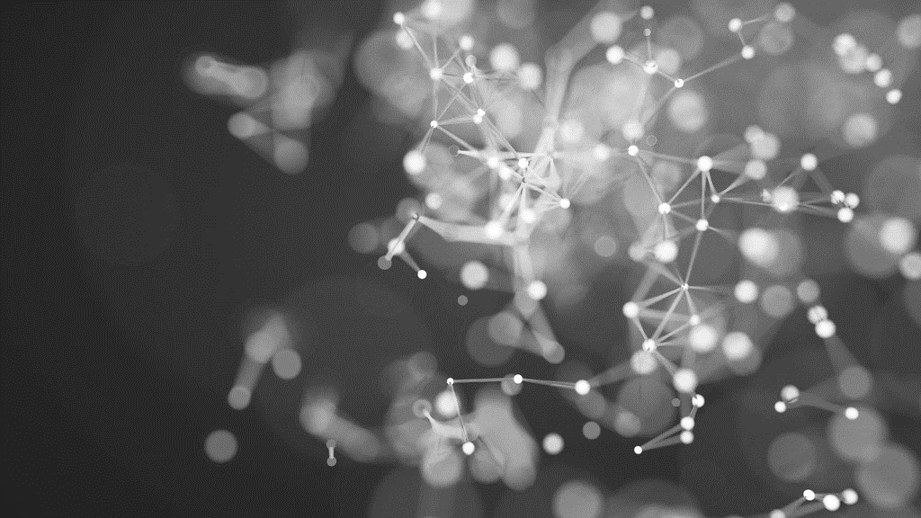
MIS 776 Business Analytics
Presented by Michael J Lee, PhD

Slide 2
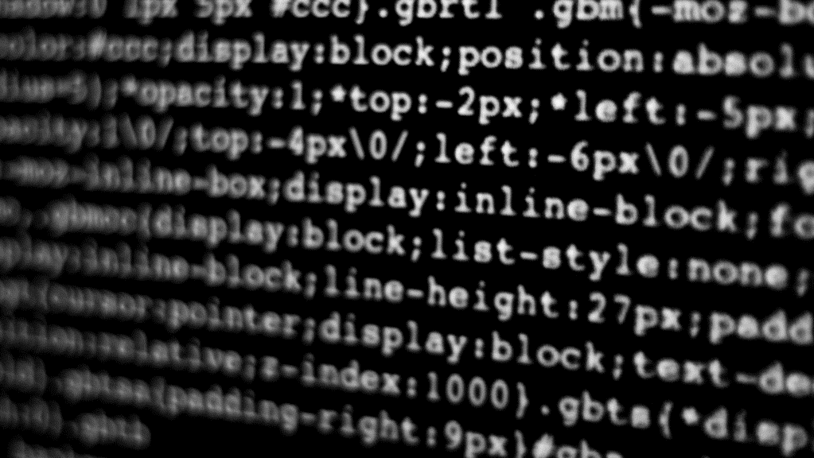
Generative Adversarial Networks

Slide 3
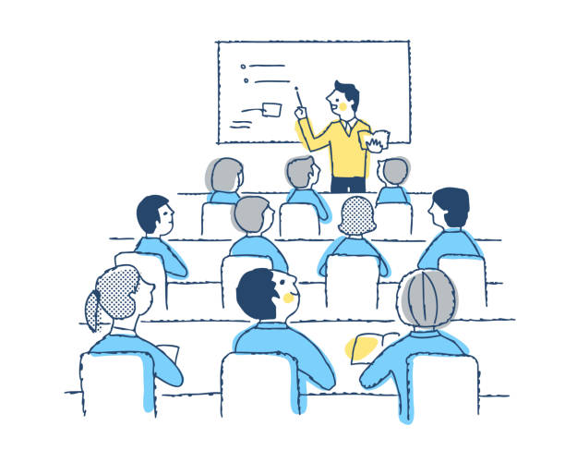
Class Business
We are nearing the final stages of the semester so please focus on the important things:
I’ll make sure that the assignments at this point are not too involved, but don’t ignore them.
Don’t miss deadlines on discussion posts.
Don’t put off the group project work
I will be travelling over Thanksgiving week.

Slide 4
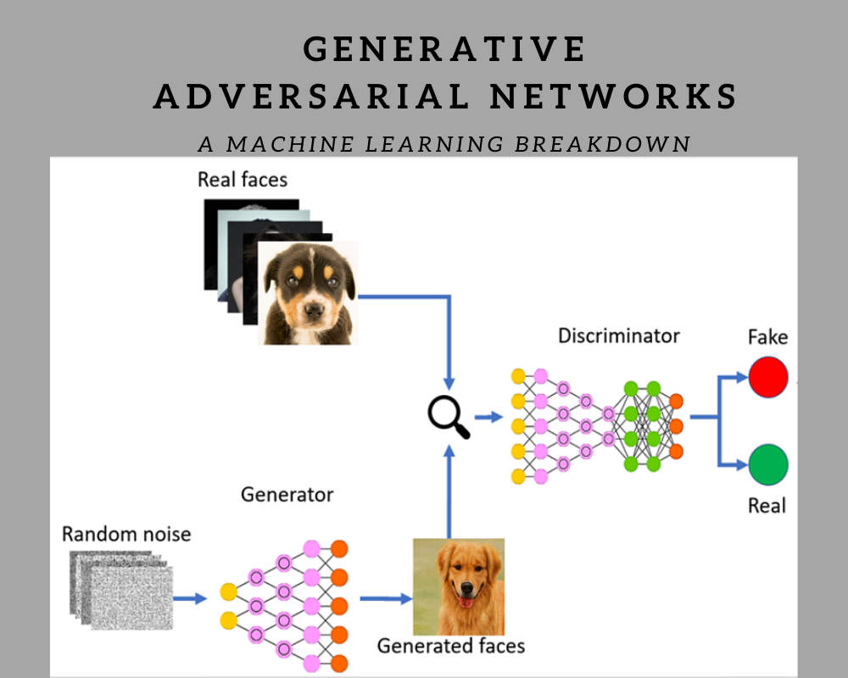
What is a Generative Adversarial Network?
Let’s break this down:
Generative: The purpose of the network is to generate content such as text, images, music, etc.
Adversarial: The learning mechanism is based on adversarial game theory, trying to fool the system.
Network: The execution context, using a deep learning network, often a CNN.

Slide 5
Two major components of a GAN
Generator
Using input artifacts, a generator creates new artifacts in the style of the inputs.
Analyzes the inputs and uses the structure of the inputs to generate a mimic.
Discriminator
Evaluates the generated artifact to determine if it is real or fake.
If fake, it provides information to the generator about why it made that determination. Generator corrects and process repeats.
If it decides that it is real, the generated artifact is accepted.
These two components are adversaries, continually trying to outdo each other.

Slide 6
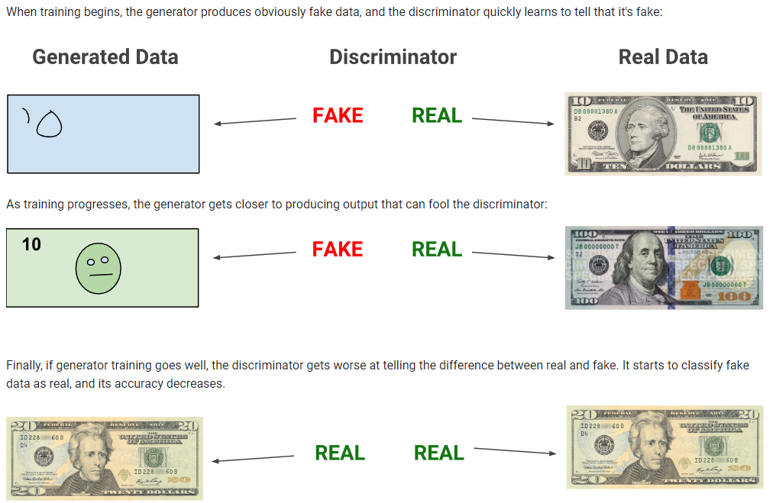
Illustration
Source: https://developers.google.com/machine-learning/gan/gan_structure

Slide 7
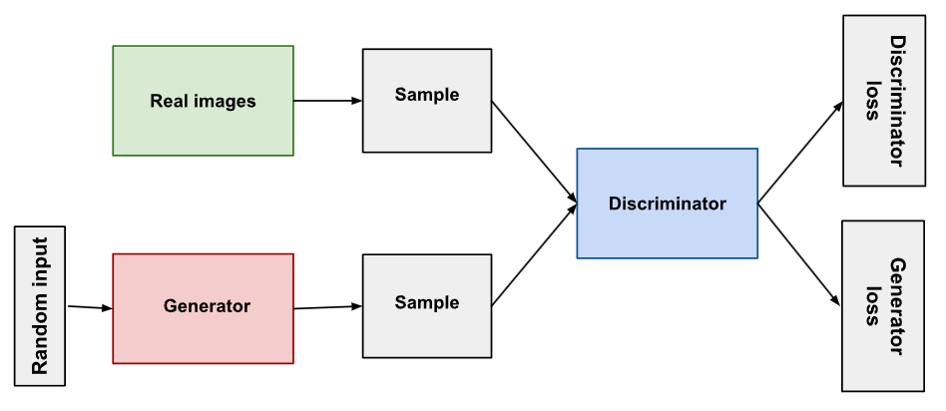
Conceptual model of the System

Slide 8
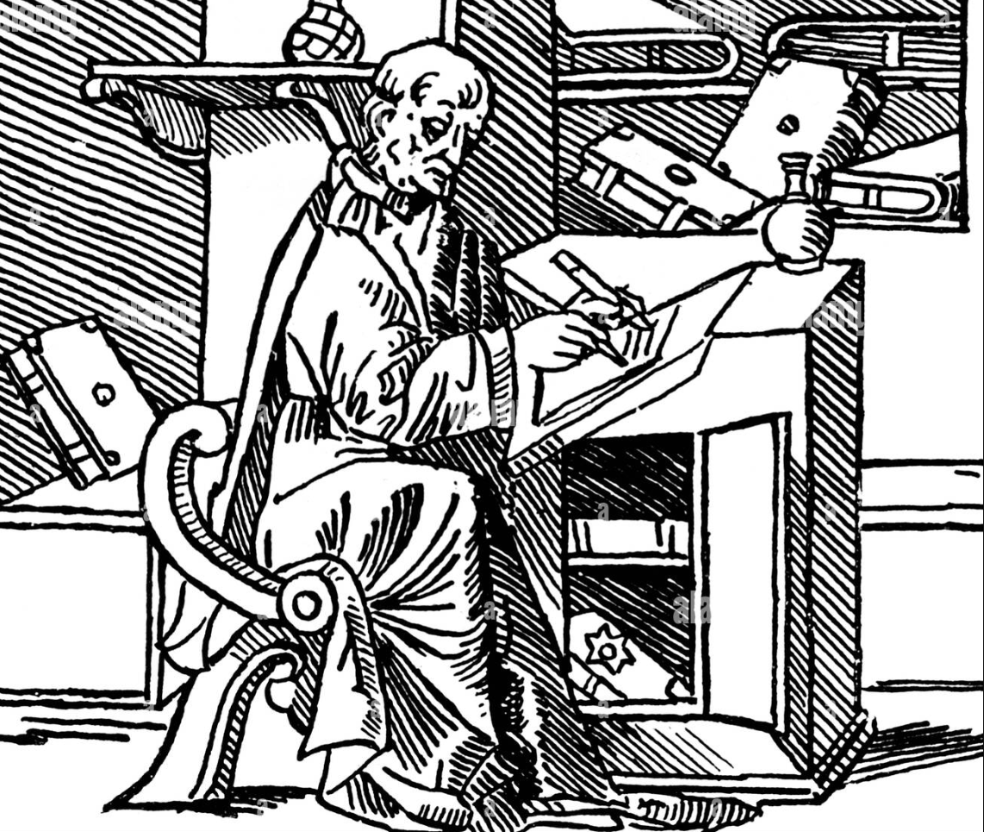
What can you generate with a GAN?
Images
Music
Text
Is this what Chat GPT does?
In short, no
GANS predate GPT
GANS require less training data that GPT
The mechanism is different as GPT does not use a discriminator

Slide 9
What can you do with a GAN?
Create an image using the main themes of actual images
Image transition
Example: converting horses to zebras
Modify the attributes on an image
Gender swap
Aging / de-aging
Combining multiple images to create a new one
Example is Neural Style Transfer where base image can be transformed in the style of a style reference image
Recode a low-res image to improve the resolution

Slide 10
Demo
Modifying an Image with Neural Style Transfer

Slide 11

Assignments for this week
Stay current in your reading
Xiao Chapter 9
Discussion 10: What can we learn from conflict?
Project submissions are getting closer, so don’t put this off

Slide 12
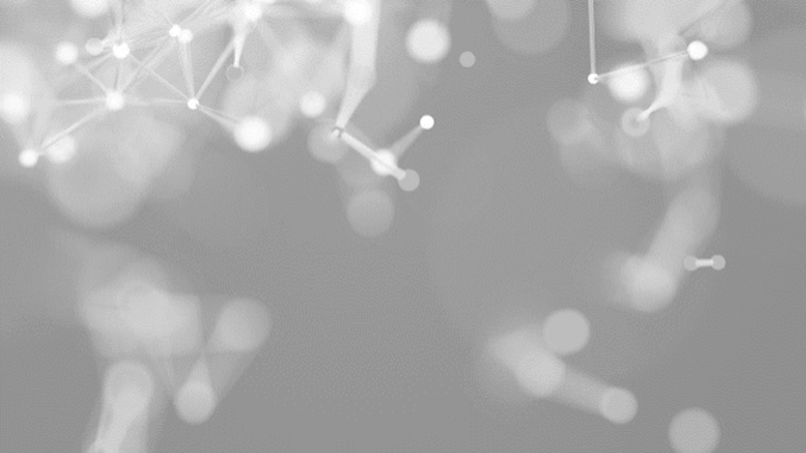
Questions?
Contact me via Web Campus
Or email at:
michael.j.lee@unlv.edu

